Slide 1

Marketing101
Assignment
Team 1
Lokesh .R
Rahul Sheoran
Teja Krishna
Vijay Prashant
Prepared by Team1
March 20th, 2023

Slide 2
Agenda
Introduction
Executive summary
Different types of segment
Digital savvy spenders
Golden Gems
The Ageless Elite
The Balance Boosters
The VIP Roadsters
Wise Wendys

Slide 3

Introduction
The BeneFit Company (TBC) is a full-service insurance group based in Maryland
serving the United States including; Maryland, DC, Virginia, and Pennsylvania.
Motto :-Finding insurance solutions to help clients handle challenges is our commitment.
1)Employment Services
3)Payroll services
5)Business insurance
2)Group insurance
4)Individual Services

Slide 4
Executive summary
Size of the populations
Segment 1- 20,701
Segment 2- 41,899
Segment 3- 34,312
Segment 4- 35,356
Segment 5 – 27,975
Segment 6- 39,753
Giving the Perseptive of each segment based on the given data .
The goal is to tell the company how to market they insurance for the different segment in the different way.

Slide 5

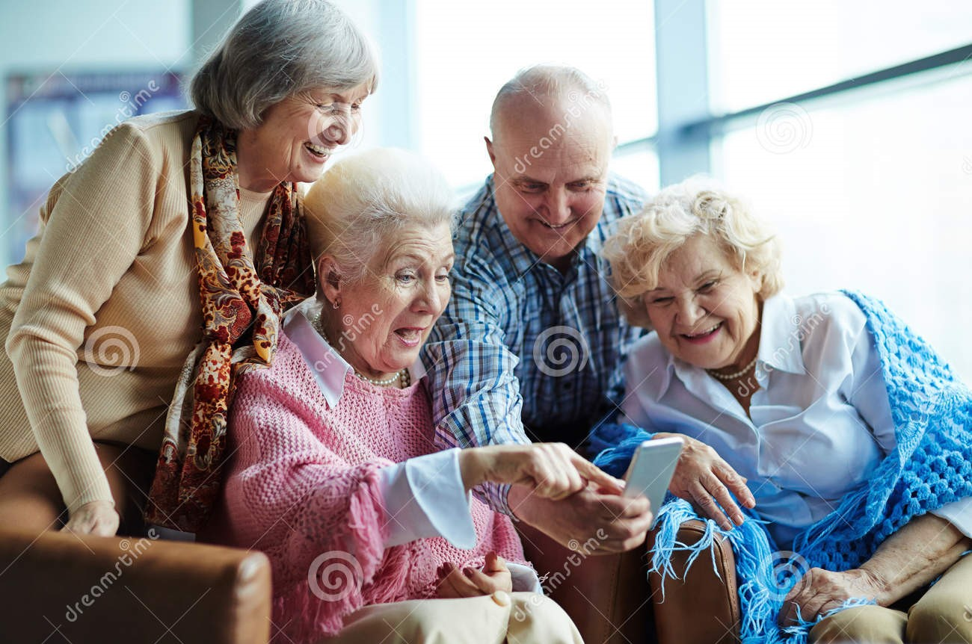
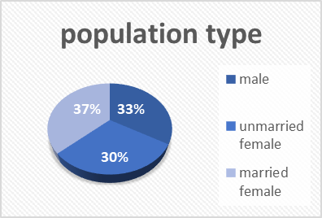


Digital Savvy Spenders
Suggestions - online portals and Social media
01
Low
Mid
High
Financial
status
The average age of this group is 55.
They budget their finances and have over $50,000 in wealth resources and use low interest credit cards
80% of individuals prefer online transactions, are active on Facebook and Twitter.
97% of people are book readers, with 32% interested in medical and health-related books.
Health-conscious book readers are highly willing to participate in sports, pay attention to diet and nutrition, and often report
…....having health conditions like allergies and high blood pressure.
About 40% of the population is likely to donate to cancer treatments/patients.
Aligning marketing strategies with altruistic interests can increase brand loyalty and drive sales.
They are more likely to buy used mid-size cars.
High
Mid
Low
Football
Baseball
80.39 % are of SFDU
Average 2 people in Houshold
Basketball

Slide 6
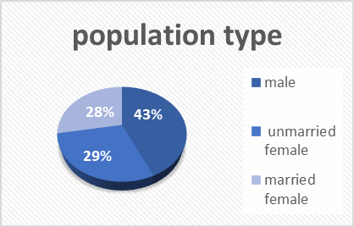
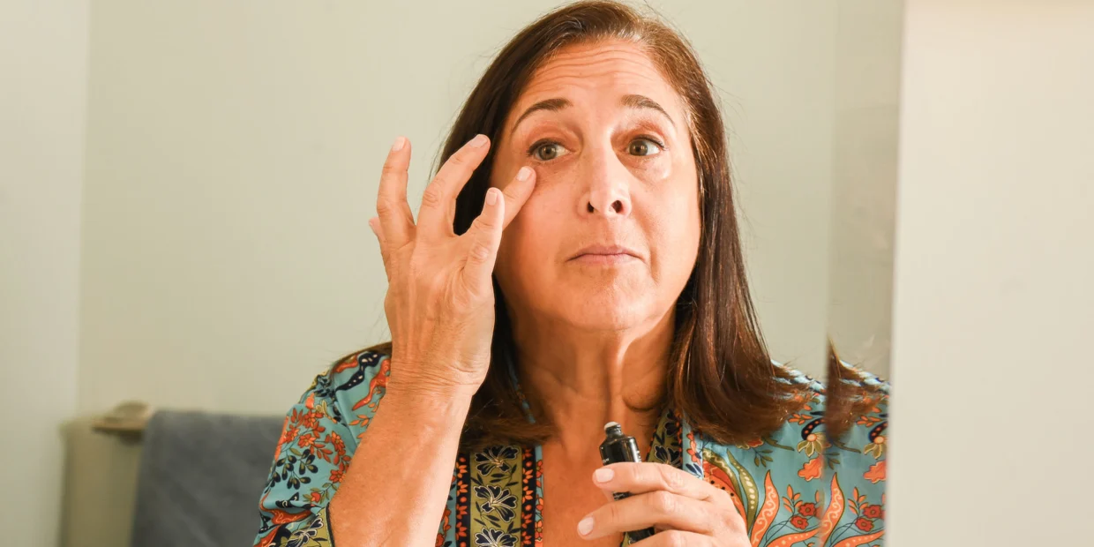
Golden Gems
Suggestions - Leverage direct mail campaigns, Offer flexible payment options
02
Low
Mid
High
Financial
status
The population is predominantly above 75 years of age.
The market size is dominated by individuals with a wealth of 30-35k dollars.
These individuals frequently switch their online purchase channels.
They prefer to pay in cash
They buy health and beauty products via mail.
They enjoy participating in sports but are not exercise enthusiasts.
They do not use iPhones.
They are very likely to purchase new non-luxury vehicles.
High
Mid
Low
Football
Baseball
76.32 % are of SFDU
Average 2 people in Household
Basketball

Slide 7
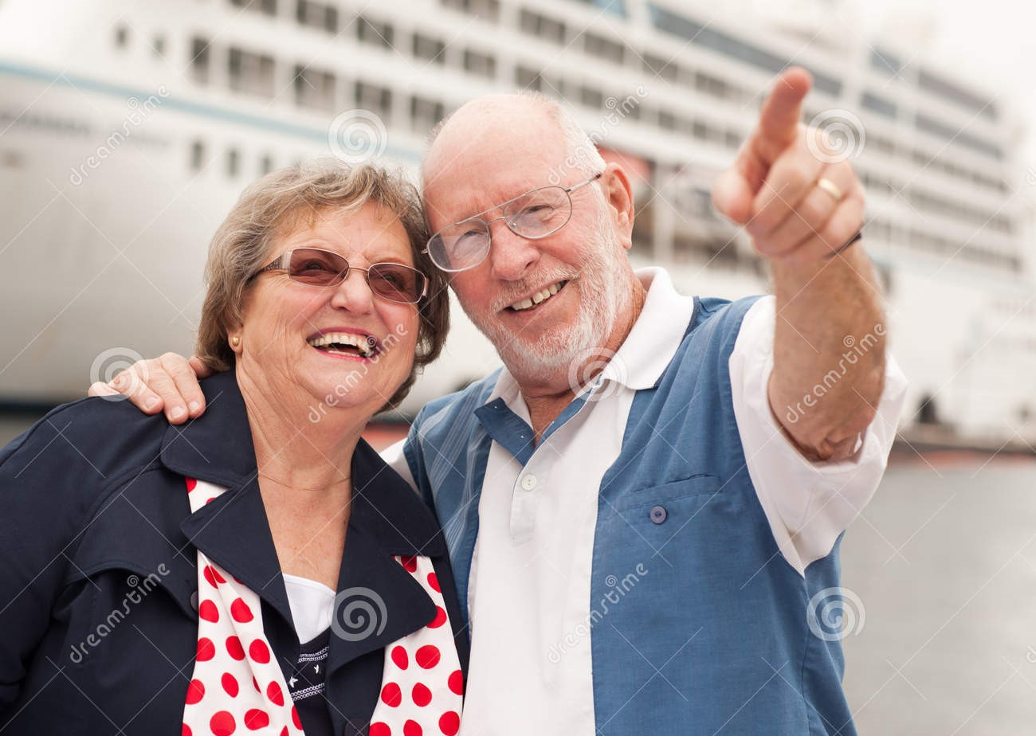
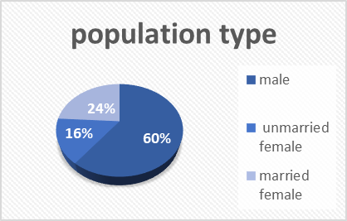
The Ageless Elite
Suggestions - Offer discounts for loyalty ,Leverage referrals ,Print advertising
03
Low
Mid
High
Financial
status
Majority of target audience has $4lac in wealth, with an average age of 72.
Health enthusiasts who enjoy magazines, sports, and cruises.
No social media presence, so traditional advertising methods are more effective.
Multiple policy ownership, prefer long-term plans, and value stability and security.
Comfortable with credit card usage.
Frequent charitable givers, providing an opportunity for companies to position themselves as socially responsible.
High
Mid
Low
Football
Baseball
84.72 % are of SFDU
Average 2 people in Household
Basketball

Slide 8
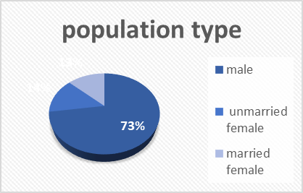
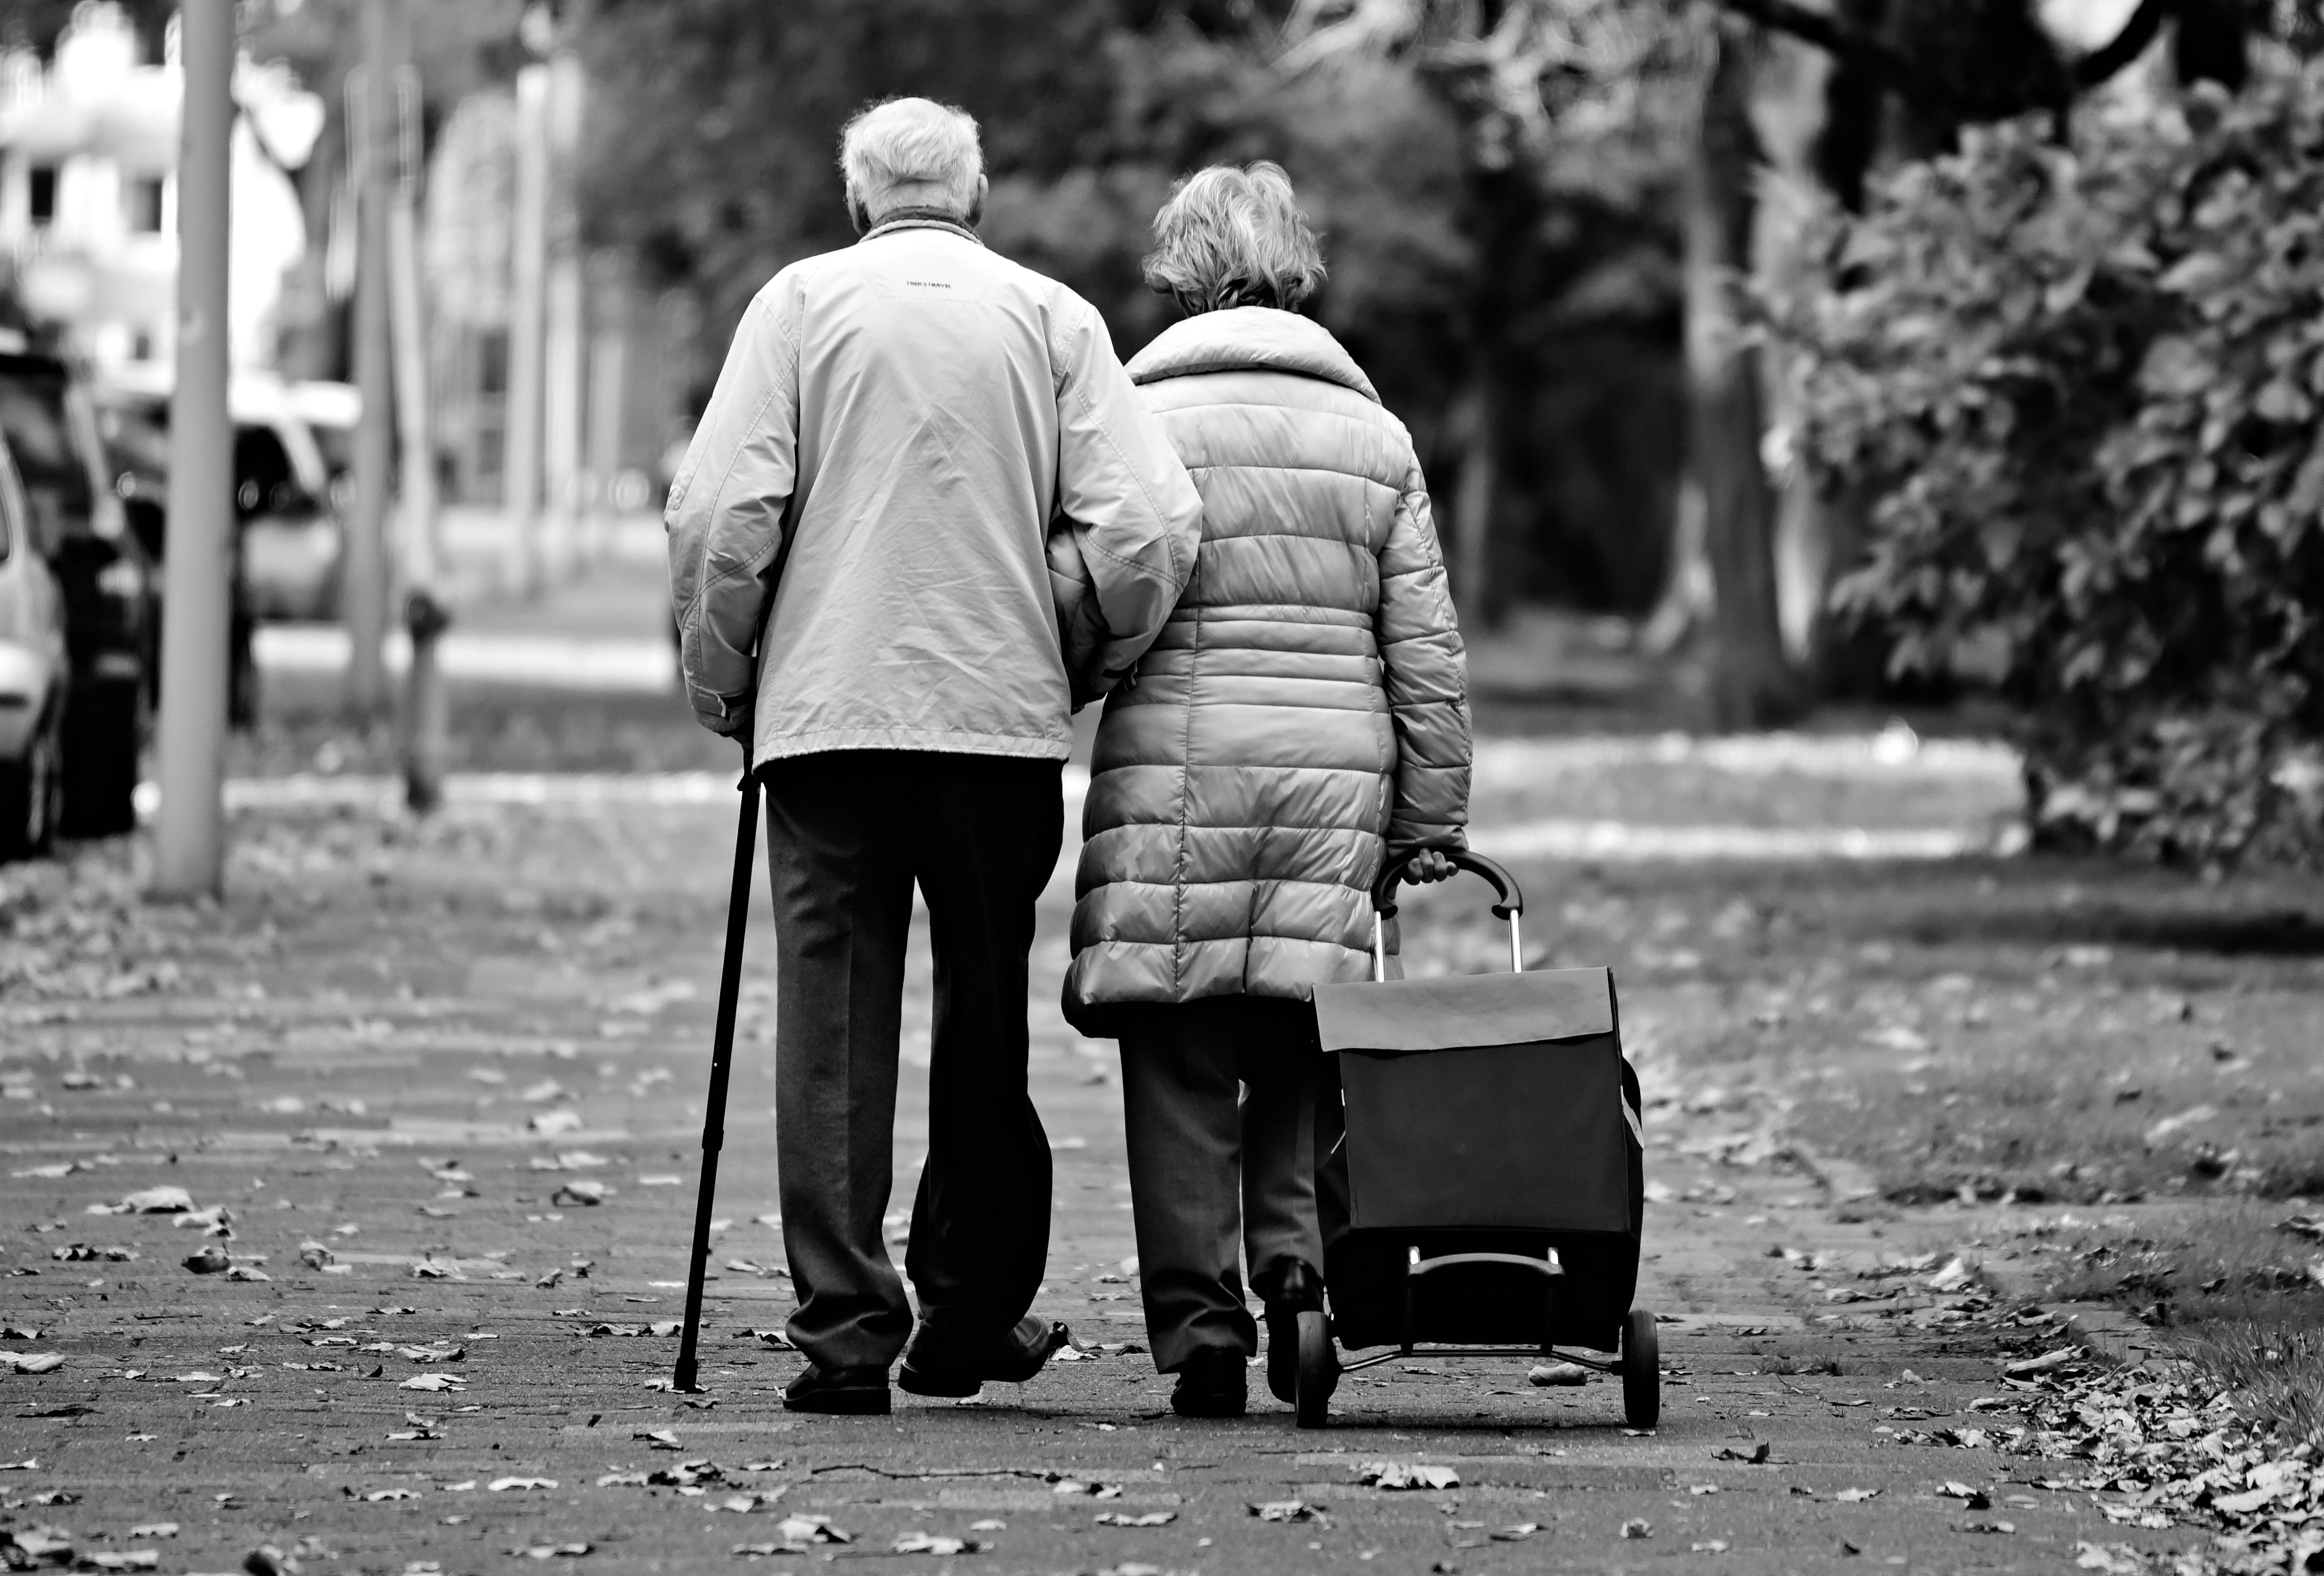
The Balance Boosters
Suggestions -In-Store Promotions,
Personalized Customer Services
04
Low
Mid
High
Financial
status
Average wealth: 1.5-2 lac dollars
Average age: 75 years
Tend to use credit cards for balance transfers.
Prefer conservative investments and often work with investment brokers
Prioritize savings accounts and Frequently visit grocery stores
More likely to buy SUVs
May not be particularly health-conscious or involved in sports
Health insurance plans should offer affordable coverage with preventive care services
High
Mid
Low
Football
Baseball
80.57 % are of SFDU
Average 2 people in Household
Basketball

Slide 9


The VIP Roadsters
Suggestions - Amazon Prime Advertising ,Targeted advertising and
High-end events.
05
Low
Mid
High
Financial
status
They have an average age of 69 years.
More than 90% of this segment has a wealth of 10lac+ dollars.
They tend to use specific hotel loyalty programs and are active users of investment resources.
Most people in this segment are iPhone users and They prefer personal travel more than 11+ days a year
They have a high frequency of cultural event attendance and tend to attend live music shows.
They prefer to purchase imported luxury vehicles.
They are also subscribers of Amazon Prime and own satellite radios.
High
Mid
Low
Football
Baseball
85.93% are of SFDU
Average 2 people in Household
Basketball

Slide 10


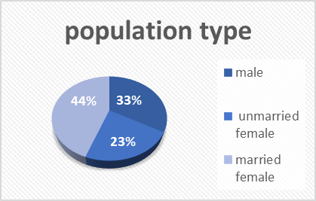
Wise Wendys
Suggestions - Educational webinars,
Local community events
06
Low
Mid
High
Financial
status
This is a group of budget-conscious individuals who are over the age of 73.
This group is comprised of online degree seekers who are looking to learn new skills.
Despite having a wealth level of less than $25,000, these individuals are savvy consumers who prioritize affordability in their ….....purchases.
They choose to use low-cost home cleaning products
They purchase their auto insurance online
In order to save money, this group does not pay for traditional TV subscriptions and instead opts to stream their favorite shows for ….....free
Although they do not invest, these individuals are committed to improving their knowledge and skills through online education.
High
Mid
Low
Football
Baseball
60.38% are of SFDU
Average 1 people in Household
Basketball

Slide 11

Thanks
www.blend360.com
@OfficialB360
Blend360
blend360_solutions

